Slide 1

Tourism and travel

Slide 2
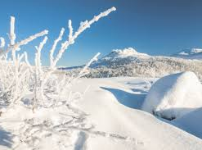
Sweden
The snow and cold weather is a big factor for the swedish tourism and its activities.
so If the global warming continues it will mostly effect the northern part of sweden
If the snow dissapear, less people will come to sweden which means that many jobs related to tourism will be lost.

Slide 3
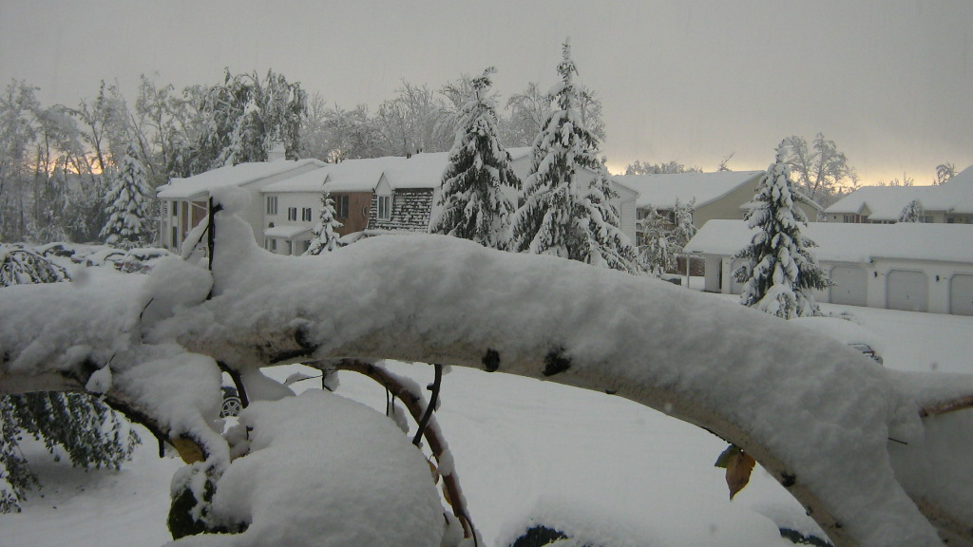
How can Sweden handle the changes?
The Swedish goverment can give economic support to the tourism sector
The Swedish can also spread more awareness about global warming to combat it.
We can come up with new tourism activities that are fitted for the warmer weather and the new environment that has less snow.

Slide 4
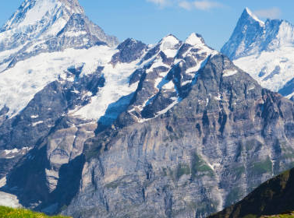
Italy
The ice in the alps melt and the sea and water levels rise
Animal species immigrate
More mosquitoes that spread malaria and other diseases
These things effect the tourism

